Slide 1



Building Beautiful Apps using
Google Flutter
By
Ahmed Abu Eldahab
/FlutterEgypt
/FlutterEgypt

Slide 2

What is Flutter?
What is Flutter?
A multi-platform mobile app SDK
●
A multi-platform mobile app SDK
●
flutter.io
flutter.io
for Android, iOS and Fuchsia
for Android, iOS and Fuchsia
Uses Dart - compiles to efficient ARM code
●
Uses Dart - compiles to efficient ARM code
●
Rich Widget catalog
●
Rich Widget catalog
●
Modern, React inspired View-Framework
●
Modern, React inspired View-Framework
●

Slide 3
Flutter goals
●
Builds beautiful, fluid UIs
●
High-performance apps that feel natural on
different platforms
●
Rapid prototyping let’s you experiment freely.
●
Runs the same UI on multiple platforms, perfect
for custom branded designs
flutter.io

Slide 4
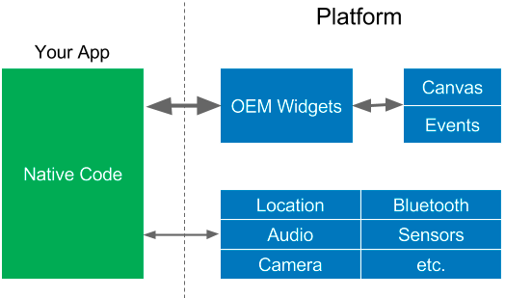
OEM SDKs

Slide 5
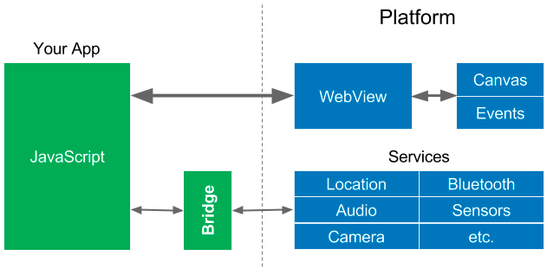
WebViews

Slide 6
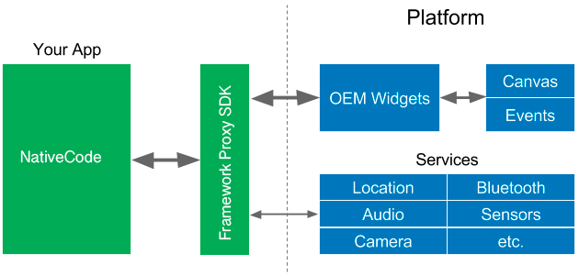
Native Proxy SDK

Slide 7

Reactive Views

Slide 8







Mobile Development Approaches
JavaScript
C#
JavaScript
JavaScript

Slide 9

Cross-Platform Approach
Google Flutter

Slide 10
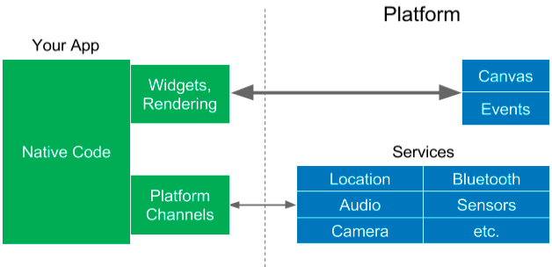
Flutter approach

Slide 11
App
Platform OS
Canvas
OEM Widgets
Input Events
React Native
JavaScript
Bridge
System Services
(Location, Bluetooth, Audio, Camera,
Sensors, etc.)
Canvas
Widget
Rendering
Input Events
Flutter
Dart ARM
code
System Services
Platform
(Location, Bluetooth, Audio, Camera,
Channels
Sensors, etc.)
All Native Binary! NO JS. NO VM.

Slide 12
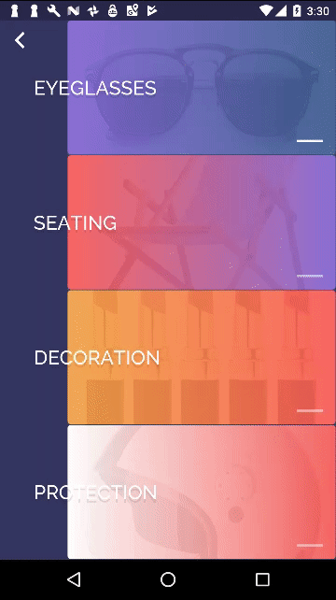


So what is Flutter ?
Flutter is the next step in
App development
Speed and performance
Fast , smooth performance
Flexibility
Customize anything
Native look and feel
Familiarity , ease of use
Rapid Development
Easy to learn , predictable

Slide 13
What makes Flutter unique?
Compiles to Native Code (ARM Binary code)
Not reliant on OEM widgets
Unlike React, there’s no bridge needed
Flutter

Slide 14

What is Dart?
Open-source web programming language developed by Google.
Class-based, single-inheritance, object oriented language with C-style syntax.
Supports interfaces, abstract classes, reified generics, and optional typing(Dart 1) and strong typing (Dart 2)..
One language to rule them all..

Slide 15
Who use Dart?
Google AdWords
Google Fuchsia
Google Fiber
AdSense
performance reports
Mandrill
AdWords for video
Google internal sales tool
Google internal CRM
Adobe
https://www.dartlang.org/community/who-uses-dart

Slide 16

Google Fuchsia
Fuchsia is a capability-based, real-time operating system (RTOS) currently being developed by Google.
https://github.com/fuchsia-mirror/

Slide 17
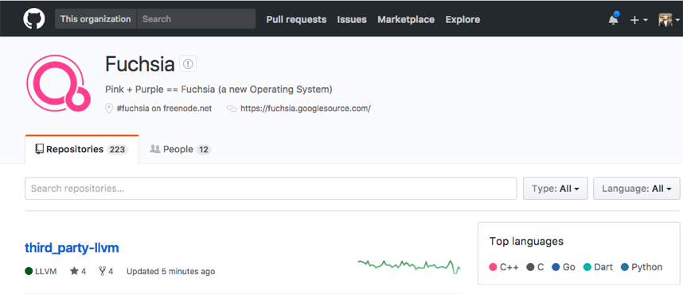

Google Fuchsia
https://github.com/fuchsia-mirror/

Slide 18
How does Flutter work?
Flutter

Slide 19
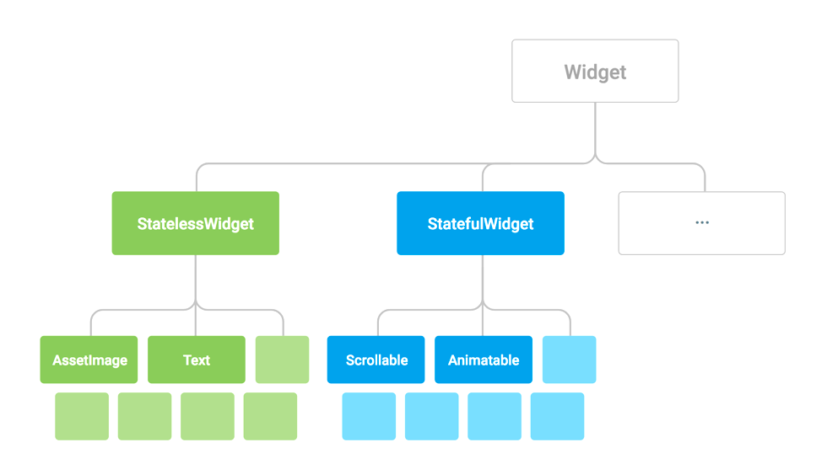
Everything is a Widget
Notes:
Every thig is a widget , we mean everyting you coffe cup , , your keyboard is a widget, your dog

Slide 20
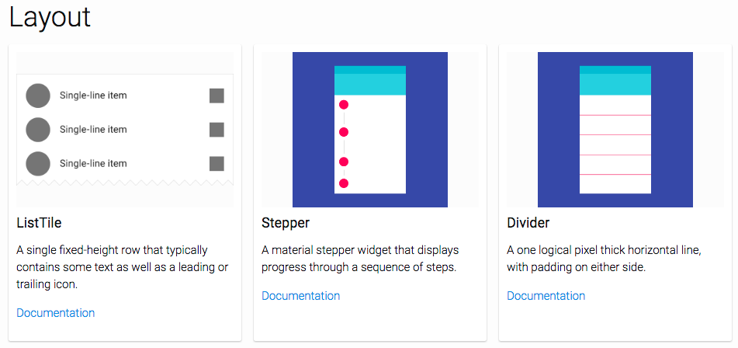
https://flutter.io/widgets/widgetindex/

Slide 21
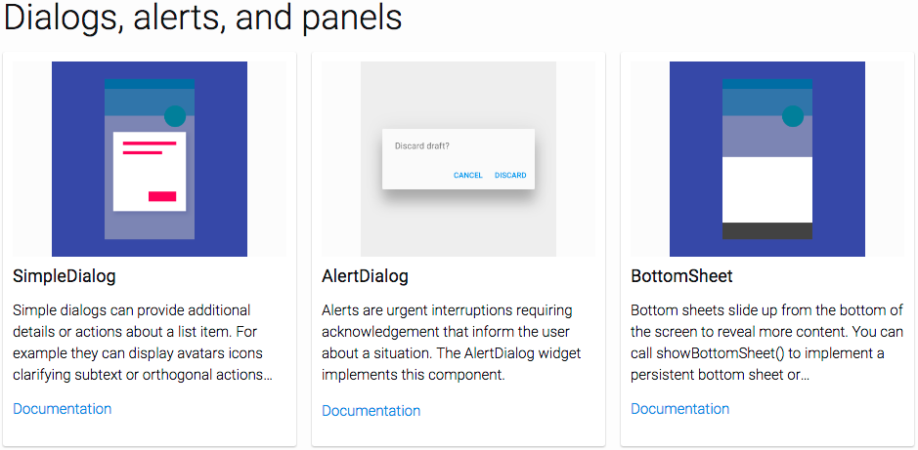
https://flutter.io/widgets/widgetindex/

Slide 22
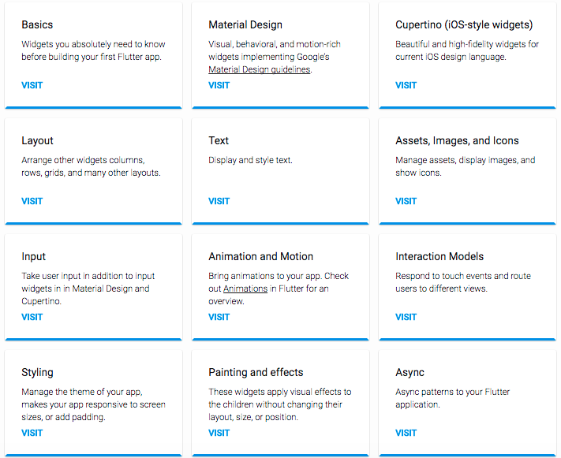
https://flutter.io/widgets/

Slide 23
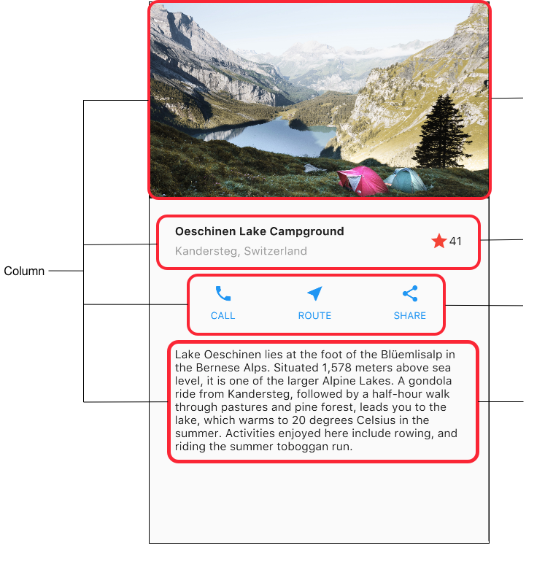
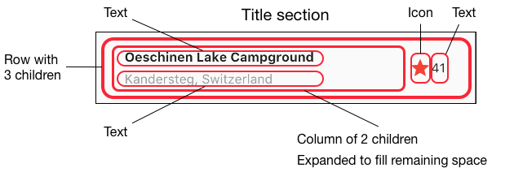
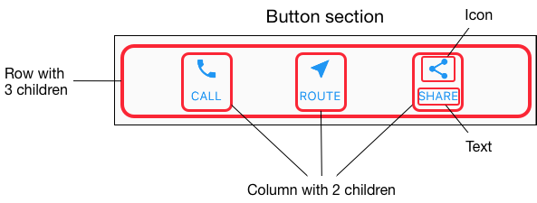
Rows and columns

Slide 24
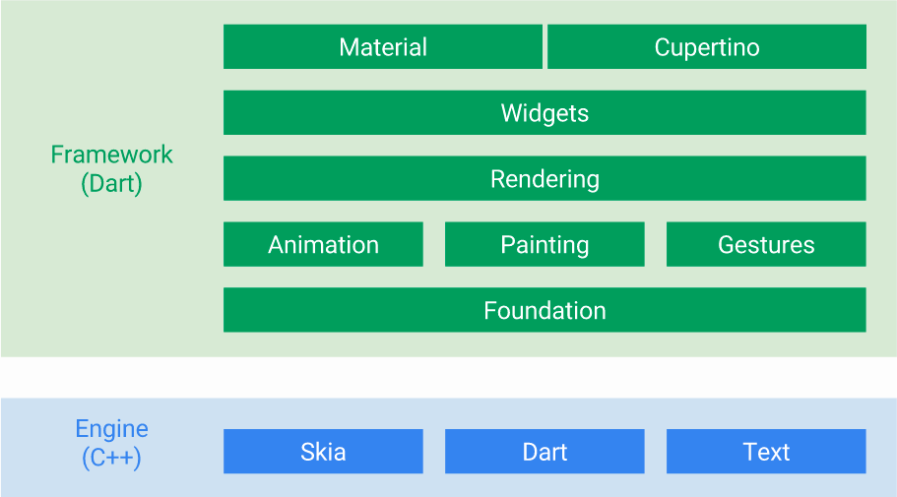
You Can customize everything in green

Slide 25
Flutter

Slide 26
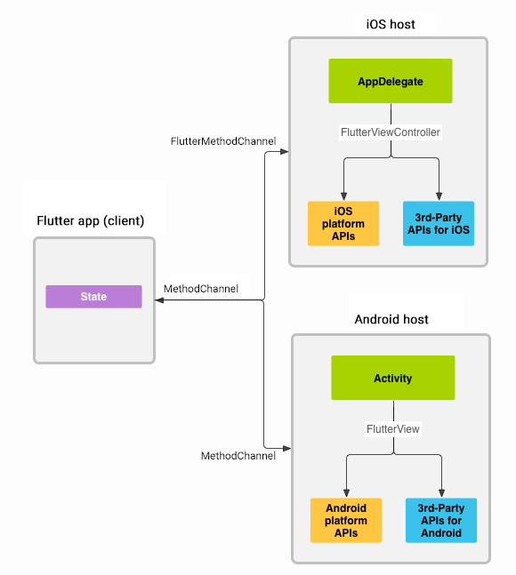
Platform channels
Flutter
https://flutter.io/platform-channels/

Slide 27
What makes Flutter unique ?
Flutter

Slide 28
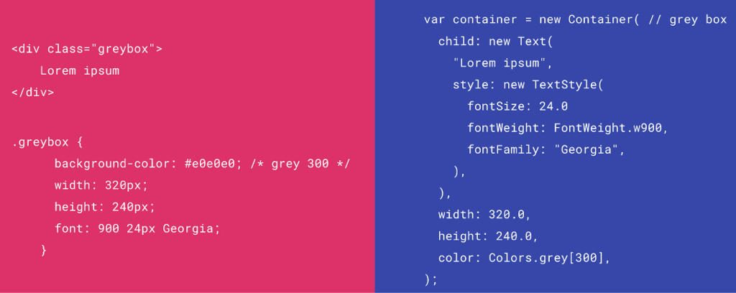
HTML/CSS Analogs in Flutter

Slide 29
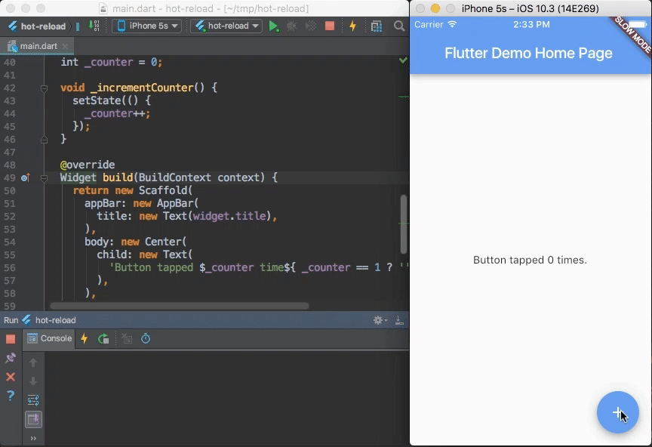
Hot Reload and Hot Restart

Slide 30
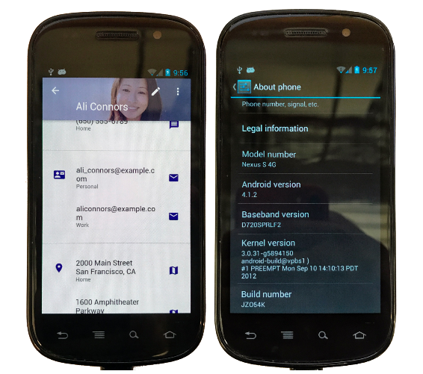
Consistent Material Design (or your design) on phones made way before Material Design existed

Slide 31





IDE Support ?

Slide 32
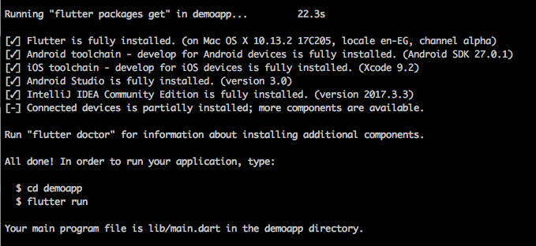
Terminal ?
$ flutter create demoapp

Slide 33
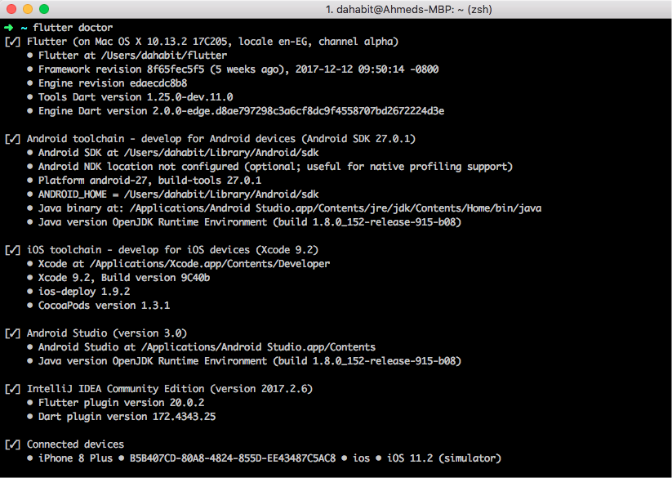
Easy Check !
$ flutter doctor

Slide 34
Over 200 Apps
are already on the Google Play Store!
(Did someone say not production ready?)

